Slide 1
Comprehensive Overview:
2025 CPT Code Updates
Compliance Office
CPT 2025 Education
December 2024

Slide 2
About This Presentation
Purpose: Overview of 2025 CPT changes
Highlights: New codes, revisions, and deletions
Impact: Key implications for practice and billing

Slide 3
2025 CPT Updates: Summary
Total changes: 420 codes
Breakdown:
  New: 270
  Deleted: 112
  Revised: 38
Notable: Expanded guidelines for virtual check-ins and telemedicine.
The 2025 CPT Manual also contains numerous guideline changes, including expanded guidance for the new CPT-based virtual check-in service and online digital E/M services.

Slide 4
Focus on Additions
Categories with most additions:
  Pathology & Laboratory (37% of new codes)
  Category III codes (30% for emerging services and AI applications)
Examples:
  0902T: AI augmentative data analysis for electrocardiogram measurements
  0877T-0880T: AI augmentative data analysis for medical chest imaging
  0898T: AI augmentative data analysis for image-guided prostate biopsy
  15011-15018: Novel approaches in skin grafts for wound care and recovery
  49186-49190: Advancements in surgical techniques for abdominal tumors

Slide 5
Important Tips: Guidelines CPT
Read the entire descriptor. Coders are not reading the full description, including text descriptors parenthesis.
Read Guideline Revisions in the following areas for new codes.
  Remember that an add-on code needs a parent code (primary code) and can not be reported alone.
  Review the revised guidance within the “preventive services” E/M section of the book. “Immunization/vaccine/toxoid products, immunization administrations, ancillary studies involving laboratory, radiology, other procedures, or screening tests (e.g., vision, hearing, developmental) identified with a specific CPT code are reported separately,” the AMA reminds you.
  The 2025 edition also adds guidance to the online digital E/M services section, covering codes 99421-99423. “If within seven days of initiating an online digital E/M service, a separately reported E/M visit occurs, then the physician or other QHP work devoted to the online digital E/M service is incorporated into the separately reported E/M visit,” the book states. “This includes E/M services provided through synchronous telemedicine visits using interactive audio and video telecommunication equipment.”

Slide 6
CPT Additions E/M: Telemedicine
Evaluation and Management Additions
  New Telemedicine codes have arrived. Payment is now questionable under the CMS Final Rule for CY 2025.
  Remember: Under CMS’ Final Rule policy, the agency will not cover this suite of services in 2025. Per CMS, “We do not believe there is a programmatic need to recognize the audio/video and audio-only telemedicine E/M codes for payment under Medicare,” CMS stated in the proposed 2025 Medicare physician fee schedule.
The codes in the CPT are for 2025 the following:
  Synchronous Audio-Video E/M ( based on MDM Level)
    New patient and Established Patients
    98000-98007
  Synchronous Audio Only( based on MDM Level)
    New patient and Established Patients
    Minimum 10 minutes of medical discussion
    98008-98015
    98016: Virtual check-ins, patient-initiated, focusing on brief discussions to assess the need for further visits.

Slide 7
Evolution of Telemedicine:
Take Aways
New E/M codes for synchronous and asynchronous visits:
  9800-98015: Audio-visual and audio-only telemedicine
  98016: Virtual check-ins (patient-initiated)
Guidelines for time reporting and service aggregation.

Slide 8
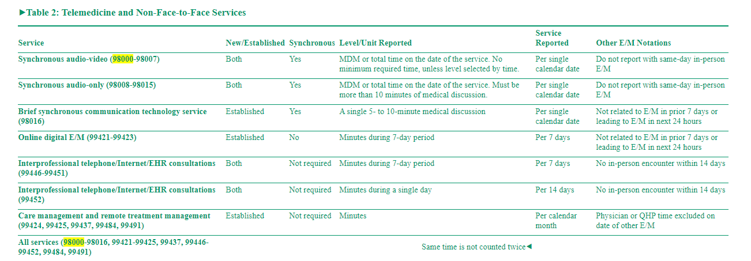
New Telemedicine Codes 2025

Slide 9
Surgery Enhancements
The Surgery section now has 33 new codes for autografts, arthroplasty, and other surgical procedures, effective January. 1, 2025.
You’ll also find some revised and deleted codes in this section.
Review guidelines for Skin Cell Suspension Autograft (SCSA)
  Code Set* NEW CODES
    15011-15018- New Codes
    15002-15005- Surgical preparation of site before application
    15040-15261-Placement of separate additional autograft
  Autografts/tissue-cultured autografts (other than SCSA)

Slide 10
The New CPT Code 25448
Effectively combines two codes: 25447 and 26480.
25448: Arthroplasty, suspension including transfer or tendon, with interposition, when performed.
  Starting in 2025, when carpometacarpal (CMC) suspension arthroplasty is performed using an interposition tendon transfer.
  Do not code 25448 with the following:
    Do not report 25448 in conjunction with 25447.
    Do not report 25448 in conjunction with 25310, 26480 when performed for intercarpal or carpometacarpal joint arthroplasty.

Slide 11
New Codes for Plane Blocks
Six new codes for plane blocks can be reported in 2025. These blocks bathe all the nerves versus targeting a specific area.
  64466 (Thoracic fascial plane block, unilateral; by injection[s], including imaging guidance, when performed).
  64467 ( … ; by continuous infusion[s], including imaging guidance, when performed).
  64468 (Thoracic fascial plane block, bilateral; by injection[s], including imaging guidance, when performed).
  64469 ( … ; by continuous infusion[s], including imaging guidance, when performed).
  64473 (Lower extremity fascial plane block, unilateral; by injection[s], including imaging guidance, when performed).
  64474 ( … ; by continuous infusion[s], including imaging guidance, when performed).

Slide 12
Temporary Code 0616T = 66683
Implantation of iris prosthesis, including suture fixation and repair or removal of iris, when performed
  Temporary code 0616T is now Permanent with CPT 66683.
  Temporary code 0616T (Insertion of iris prosthesis, including suture fixation and repair or removal of iris, when performed; without removal of crystalline lens or intraocular lens, without insertion of intraocular lens) will be deleted and replaced with permanent code 66683 (Implantation of iris prosthesis, including suture fixation and repair or removal of iris, when performed). The T code is carrier-priced, but CMS will cover the permanent code, according to the proposed rule.

Slide 13
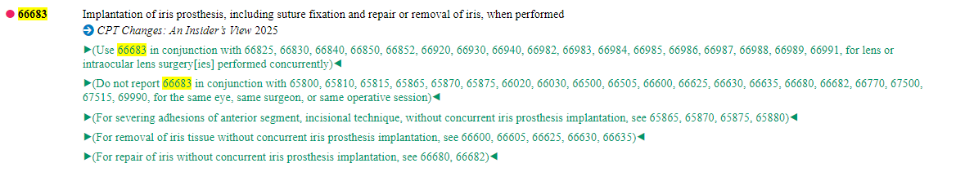
AMA/CPT Definition of Code
CPT 66683

Slide 14
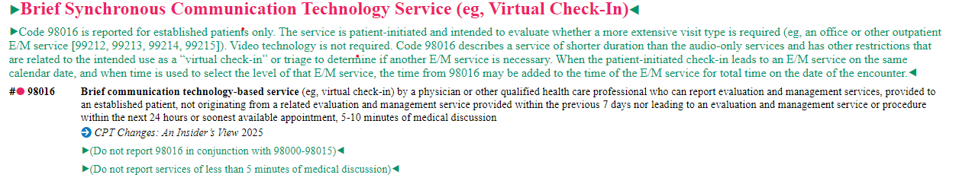
Virtual Check-In:
Goodbye to G2012
Virtual Check-In 98016: Established Patients Only
This is a patient-initiated service. The service is intended on whether a more extensive visit is required. Video technology is not needed.

Slide 15
The Role of Artificial Intelligence
New AI-focused codes:
  0902T: ECG measurements
  0877T–0880T: Chest imaging
Categorization: Assistive, augmentative, autonomous.

Slide 16
Augmented/AI – Artificial Intelligence
Category III CPT codes to classify AI medical services and procedures as assistive, augmentative, or autonomous based on the work performed by the AI application on behalf of the physician or other qualified health care professional (QHP).
Seven category III codes have been established for AI augmentative data analysis involved in electrocardiogram measurements.
  0902T and 0932T, medical chest imaging
  0877T-0880T, and image-guided prostate biopsy (0898T)

Slide 17
Editorially Revised CPT Codes for 2025
Remote Therapeutic Monitoring (RTM)
  98975
    Updated to include digital therapeutic intervention
  98976-98978
    Revised to include device supply for data access or data transmissions

Slide 18
Streamlining the Code Set
112 deletions (e.g., outdated, redundant codes)
  Examples:
    99441–99443: Replaced by telemedicine codes
    Surgical and cardiology deletions
Revised codes for modernized techniques.

Slide 19
Deleted CPT Codes for 2025
112 codes were removed to streamline and update the code set.
  Telephone E/M
    99441-99443 due to redundancy. New codes 98008, etc., replaced them.
  Cardiology Codes:
    33471 (Valvotomy, pulmonary valve, closed heart, via pulmonary artery)
    33737 (Atrial septectomy or septostomy; open heart, with inflow occlusion)
    33813 (Obliteration of aortopulmonary septal defect; without cardiopulmonary bypass)
  Examples of deletions and reasons:
    [Code X]: Outdated procedure, replaced by newer technology
    [Code Y]: Low usage, consolidated with other codes
    [Code Z]: Redundant with existing codes

Slide 20
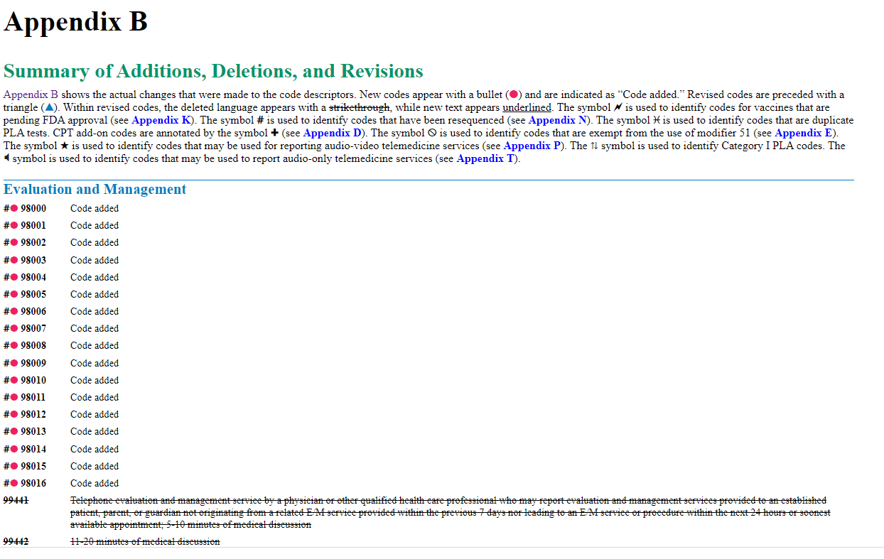
CPT Manual –Appendix B
Appendix B –Summary of Additions, Deletions and Revisions

Slide 21
Impact on Practice
Billing adjustments for new telemedicine services
Training for updated surgical and laboratory codes
Preparing for CMS coverage limitations in 2025. Final Rule Implications as of January 1, 2025, for Medicare Patients

Slide 22
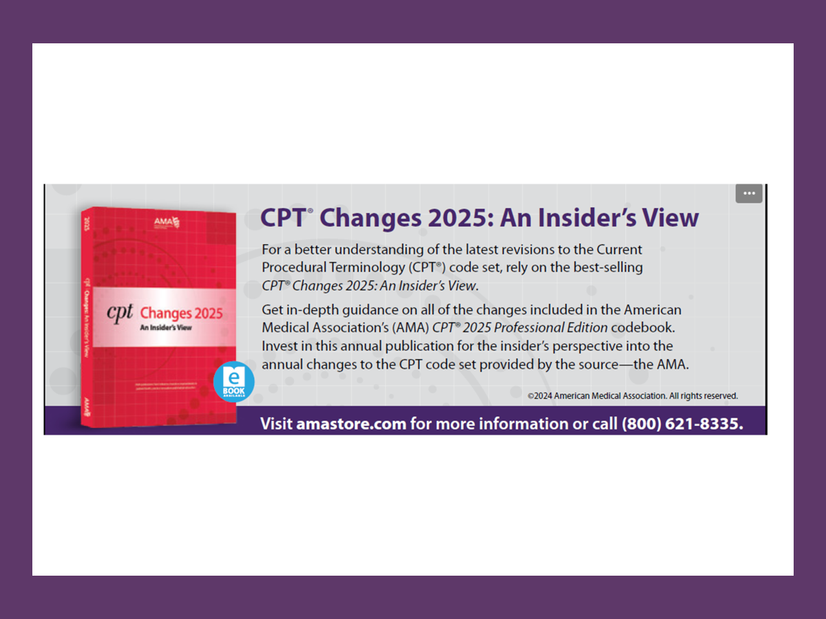
CPT Changes 2025:
An Insider’s View

Slide 23
Resources
https://pbn.decisionhealth.com/Blogs/Detail.aspx?id=201094
https://www.ama-assn.org/press-center/press-releases/ama-releases-cpt-2025-code-set
https://www.aapc.com/blog/91316-get-a-sneak-peek-at-cpt-2025/?srsltid=AfmBOorilrDiM-yiBFrMGhnlUJjTQ_Rdb1nMeCmbQ4VFkBOrrO0y43cj
https://www.aapc.com/codes/coding-newsletters/my-cardiology-coding-alert/cpt-2025-adopt-these-em-changes-before-january-1-hits-178754-article?srsltid=AfmBOoroNNGjdVOI9yArlAoJ7w-LEmb5a2WjdKZnlxvRo0vLztfawEM9

Slide 24
Learn More
AMA and AAPC references
Links to webinars, guidelines, and detailed manuals.

